Slide 1
A Decade of Action: A Strategic Approach to Coal Phase-down for China
March 8th / March 9th, 2022
Ryna Cui, Xueqin Cui, Diyang Cui, Jiawei Song, Xiaoli Zhang,
Fan Dai, Jessica Gordon, Zhinan Chen, Nathan Hultman, Daniel Kammen

Slide 2
The 2020 decade is critical in setting forth a successful path towards China’s carbon neutrality, but climate ambition is “competing” with other near-term priorities
China has committed to:
Peak carbon emissions before 2030;
“Strictly control” new coal power projects and coal consumption over the 14th FYP (2021-2025);
Phase down coal consumption during the 15th FYP (2026-2030) and make best efforts to accelerate this work;
Speed up renewable deployments to reach 1200 GW solar and wind capacity by 2030.
but increasingly emphasizes on:
A steady, step-by-step, and safe reduction of carbon emissions to avoid potential risks, hazards, and excessive side effects;
Secure energy supply to meet growing demand;
Stable grids that can support an increasing share of renewables;
More efficient, flexible, and “clean” use of coal, and it remains essential in China’s energy system.

Slide 3
How can China enable a feasible near-term coal phase-down while balancing multiple priorities?
Recent trends raise uncertainties: total coal consumption and coal fleets have been growing and may continue to grow.
In this research, we aim to:
Explore the retirement potential through 2030 by advancing multiple intersecting policy goals through the existing five-year planning processes;
Develop a strategic and practical plan for an orderly coal phase-down through targeted retirement of the low-hanging fruit (LHF) plants that can maximize the environmental, economic, and social benefits.

Slide 4
We identify individual LHF plants and demonstrate the large benefits and small risks associated with their retirements

Slide 5
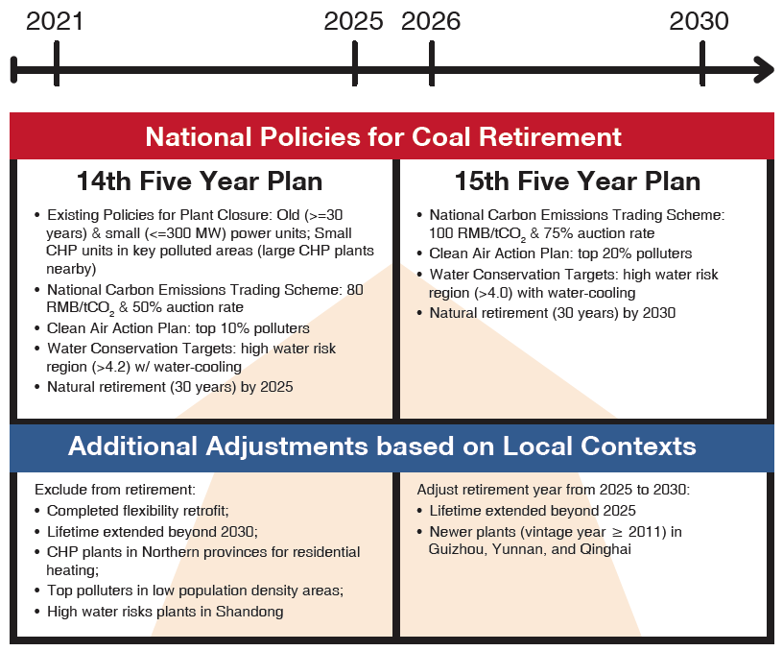
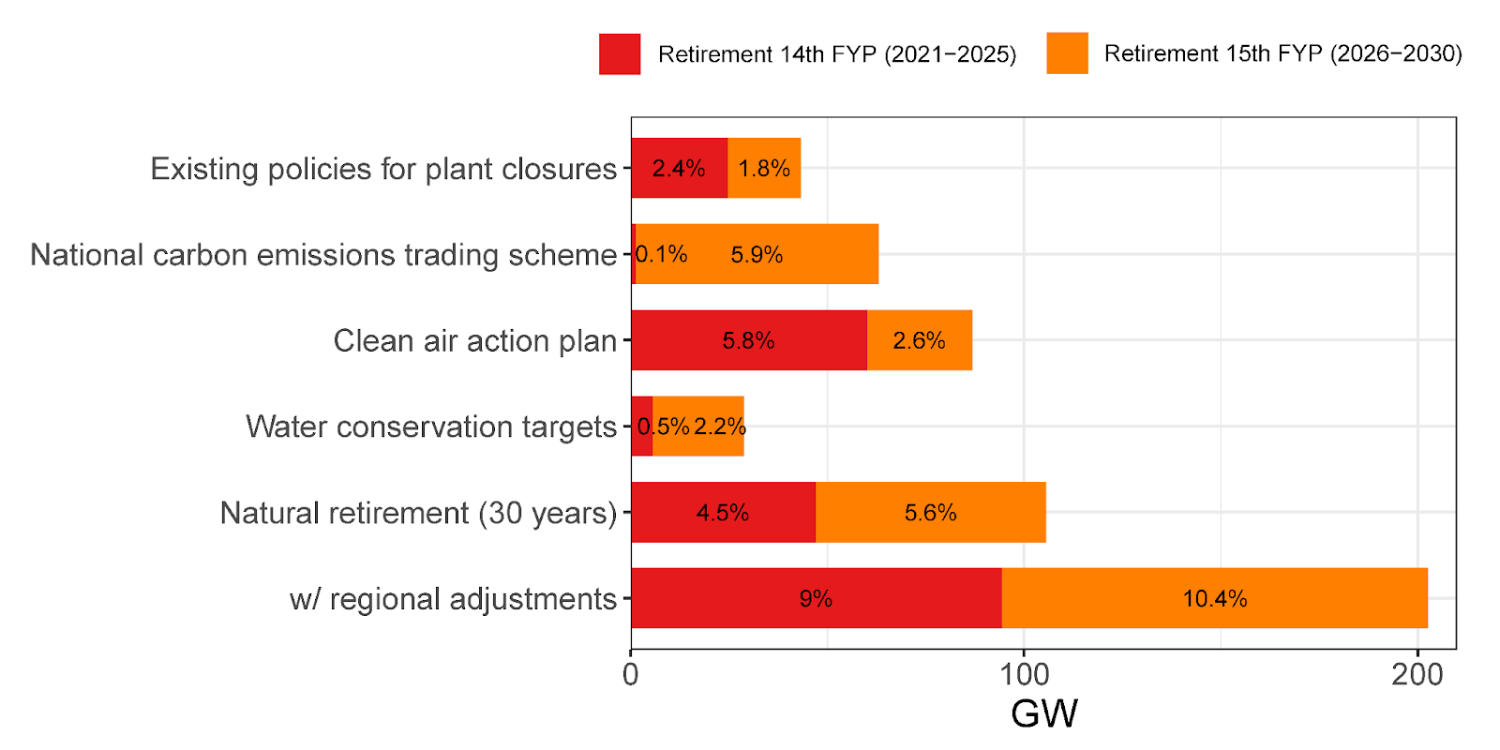
LHF retirements are evenly distributed between the 14th and 15th FYP periods, driven by different policy goals
Retirement 14th FYP: 9% of 2020 capacity (95 GW, 577 units), mostly driven by air quality goals.
Retirement 15th FYP: 10% of 2020 capacity (108 GW, 463 units), mostly driven the national ETS and water conservation targets.

Slide 6
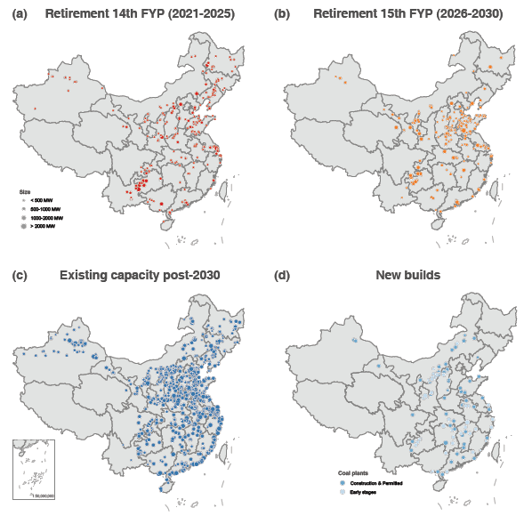
Total capacity would decline to 981 GW as LHF retirements offset new builds
981 GW
With the additional cancellation of new projects at early stages, total capacity would decrease to 981 GW by 2030.
The targeted retirements represent 19% of 2020 capacity, but 35% of generators (1,040 units) – they are smaller, older, dirtier, and less efficient.
Retirements spread relatively evenly across the central east, northeast, and southwest regions of China.

Slide 7
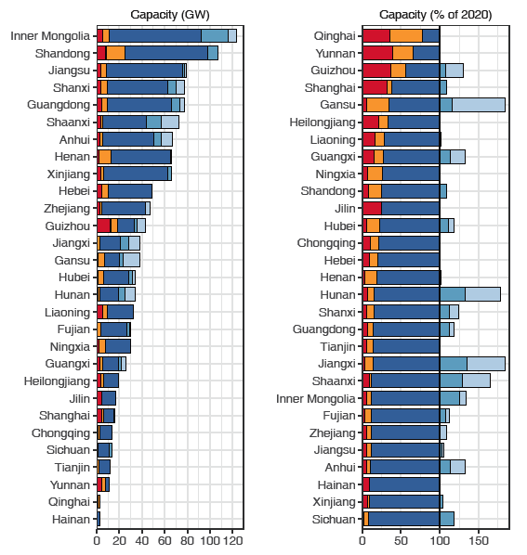
While new builds are concentrated in a few provinces, LHF retirements spread relatively evenly across regions
Shandong, Guizhou, Henan, Inner Mongolia, and Hebei have the largest potential for targeted retirements through 2030.
Jilin, Hainan, Shanghai, Shaanxi, and Guizhou have the majority of retirements during the 14th FYP.
Retired capacity exceeds 50% in Qinghai, Yunnan, and Guizhou – coal power plays a less important role in these regions because of high renewable potentials.
This helps ensure that no region is overburdened.

Slide 8
LHF retirements can generate tangible benefits with limited and manageable risks

Slide 9
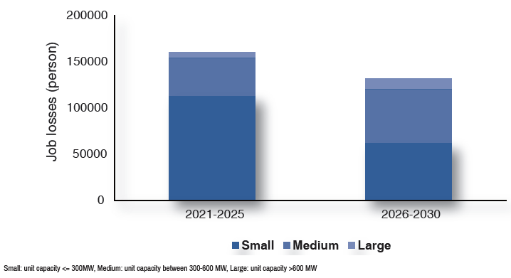
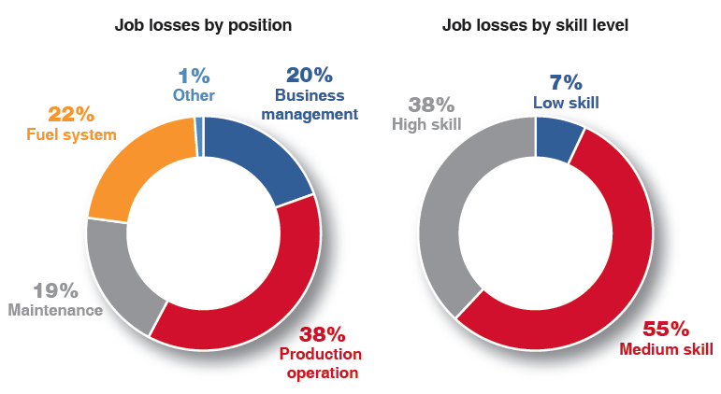
While the unemployment risks are manageable nationally, region-specific challenges need to be addressed with additional policy supports
It will lead to 293,800 job losses nationwide (33% of 2020 coal plant workers). This is a larger share compared to capacity reduction, because smaller, older plants have a larger per MW employment number.
The potential layoffs are primarily medium- and highly-skilled workers who have transferable skills for working in the growing renewable energy sector.
While on average the job losses only account for 0.02% of the total labor force nationally, it could represent 2-3% in a few counties in Inner Mongolia, Gansu, Hebei, Heilongjiang, and Shanxi.

Slide 10
Conclusion and policy discussion
Our analysis demonstrates that through a strategic and integrated planning process, China can start an orderly coal phase-down with targeted retirements of the LHF plants.
These retirements can bring tangible benefits, and the risks become manageable and are clearly outweighed by the benefits.
Coupling this carefully structured retirement plan with feasible levels of accelerating renewable energy, energy efficiency, transmission, storage, and load balancing can enable a coal phase-down in China while fulfilling growing demand within this decade.
Chinese national and subnational governments could begin implementation with the following steps:
Conduct a plant-level review to identify an early retirement schedule and strategy.
Combine this strategy with an analysis of renewable energy, grid, storage and transmission investment and fiscal planning to fund these investments and to replace any lost tax revenues.
Evaluate the job losses and their composition at the county level and provide dedicated fiscal and capacity-building support for actions such as job training for impacted workers.

Slide 11
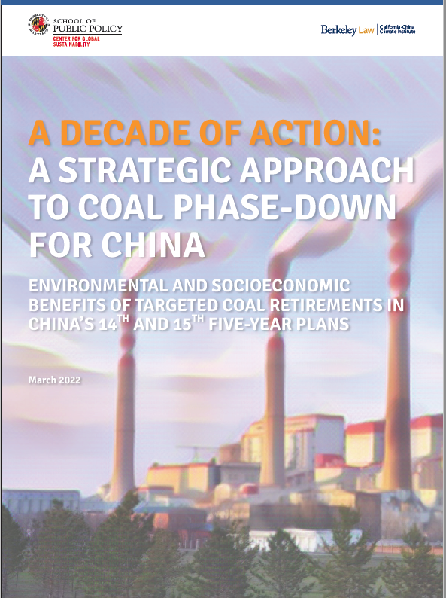
Thank you!
Ryna Yiyun Cui, PhD
China Program Co-Director, Center for Global Sustainability
Assistant Research Professor, School of Public Policy
University of Maryland, College Park
ycui10@umd.edu

Slide 12
LHF retirements can help achieve air quality targets in the key air pollution control regions
Beijing-Tianjin-Hebei region
Yangtze River Delta
Fenwei Plain

